Slide 1
Importance of Data Analytics in
AI
Arun Kumar

Slide 2
Data Science?
Data Science is the science of all data
Extraction, Manipulation, Modelling
Large amount of data!
Data + Algorithms = Data Science

Slide 3
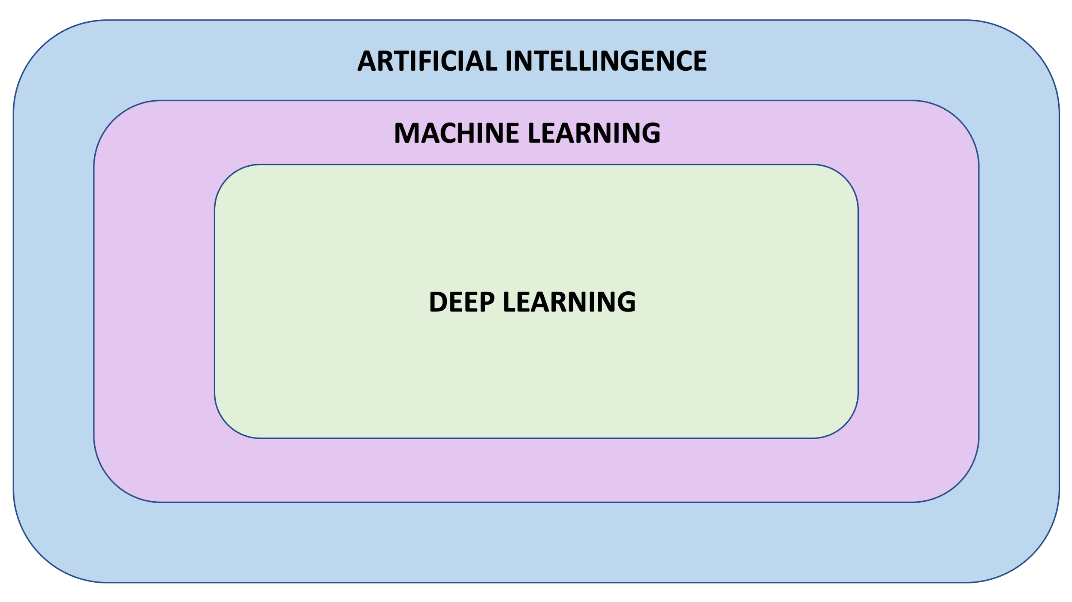

Slide 4
Roadmap for AI Project
Collect data - APIs, Databases, Surveys etc.
Cleaning data
Understanding the data and Domain of problem (Data Analysis)
Preprocessing the data
Building a model
Iterate and improve
Reporting

Slide 5
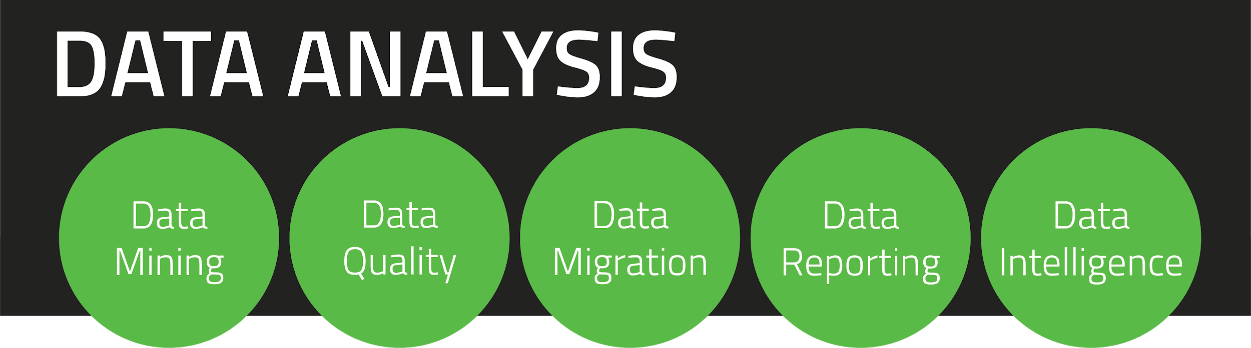
Data Analysis
Most important and most overlooked!
Gives insights on the domain of problem.
Tells about the relationships and patterns in data
Removing unwanted features is crucial

Slide 6
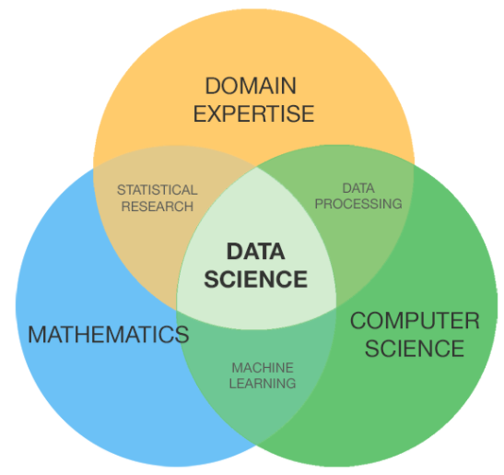

Slide 7
Practical Time

Slide 8
Any Questions?
Thank You!

